Slide 1

Decision Theory (1)
Chris Kiekintveld

Slide 2
Decision Theory
Elements of decisions
Events/states of nature
Actions
Outcomes (Actions X States)
Utilities
What is the “best” action?

Slide 3
Decision Tables
Enumerate actions/possible outcomes
Basic version specifies a single utility for each
Apply a decision rule to select an action
Likelihood:
0.5
0.4
0.1
Security Investment/Threat | Low Threat | Med Threat | High Threat
Low Security | 0 | -2500 | -15,000
Med Security | -500 | -1000 | -10,000
High Security | -2,500 | -1,500 | -3,000

Slide 4
Dominance Principle
Some decisions are (relatively) easy
Dominance principle: If action A has a higher utility than B in all outcomes, choose A
Dominated actions are that are always worse than some other action
Can be used to prune bad actions

Slide 5
Dominance Example
No security is dominated by low security
Security Investment/Threat | Low Threat | Med Threat | High Threat
No Security | -1,000 | -5,000 | -25,000
Low Security | 0 | -2500 | -15,000
Med Security | -500 | -1000 | -10,000
High Security | -2,500 | -1,500 | -3,000

Slide 6
Four Basic Decision Criteria
What if the right action is not obvious?
The best action depends on the state of the world/outcome…
 | Forward Looking | Backwards Looking
Average Case | Maximize Expected Value | Minimize Expected Regret
Worst Case | Maximize Minimum Value | Minimize Maximum Regret

Slide 7
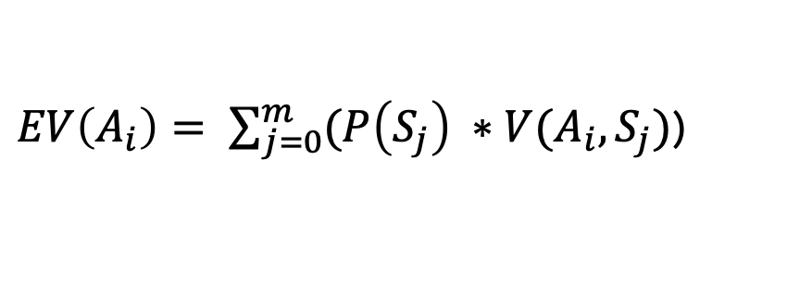
Maximizing Expected Value
One answer for choosing an action is to select the action that results in the maximum expected value
Combines probability/utility theory
Value/utility is a random variable
Assumes risk neutrality
$EV\left(A_{i}\right)= \sum_{j=0}^{m}{(P\left(S_{j}\right) ∗V(A_{i}, S_{j})}$)

Slide 8
Maximizing Expected Value
Expected
Utility
Likelihood:
0.5
0.4
0.1
Security Investment/Threat | Low Threat | Med Threat | High Threat
Low Security | 0 | -2500 | -15,000
Med Security | -500 | -1000 | -10,000
High Security | -2,500 | -1,500 | -3,000
-2500
-1650
-3000
E(Med Security) = 0.5*-500 + 0.4*-1000 + 0.1*-10000 = -1650

Slide 9
Maximizing Minimum Value
“Distribution free” approach
Does not use probability information
Maximize the worst-case outcome (“robust”)
Can be very pessimistic

Slide 10
Maximizing Minimum Value
Mimimum
Utility
Likelihood:
0.5
0.4
0.1
Security Investment/Threat | Low Threat | Med Threat | High Threat
Low Security | 0 | -2500 | -15,000
Med Security | -500 | -1000 | -10,000
High Security | -2,500 | -1,500 | -3,000
-15,000
-10,000
-3000
Med Security = Min(-500,-1000,-10000) = -10000

